Slide 1

Blockchain Technology by Parth Mandaliya MTECH sem 1

Slide 2

BLOCKCHAIN TECHNOLOGY
Blockchain technology is a structure that stores transactional records, also known as the block, of the public in several databases, known as the “chain,” in a network connected through peer-to-peer nodes. Every transaction in this ledger is authorized by the digital signature of the owner, which authenticates the transaction and safeguards it from tampering. Hence, the information the digital ledger contains is highly secure.
Blockchain is a method of recording information that makes it impossible or difficult for the system to be changed, hacked, or manipulated. A blockchain is a distributed ledger that duplicates and distributes transactions across the network of computers participating in the blockchain.

Slide 3
Cryptocurrency
A cryptocurrency, crypto-currency, or crypto is a digital currency designed to work as a medium of exchange through a computer network that is not reliant on any central authority, such as a government or bank, to uphold or maintain it. It is a decentralized system for verifying that the parties to a transaction have the money they claim to have, eliminating the need for traditional intermediaries, such as banks, when funds are being transferred between two entities.

Slide 4
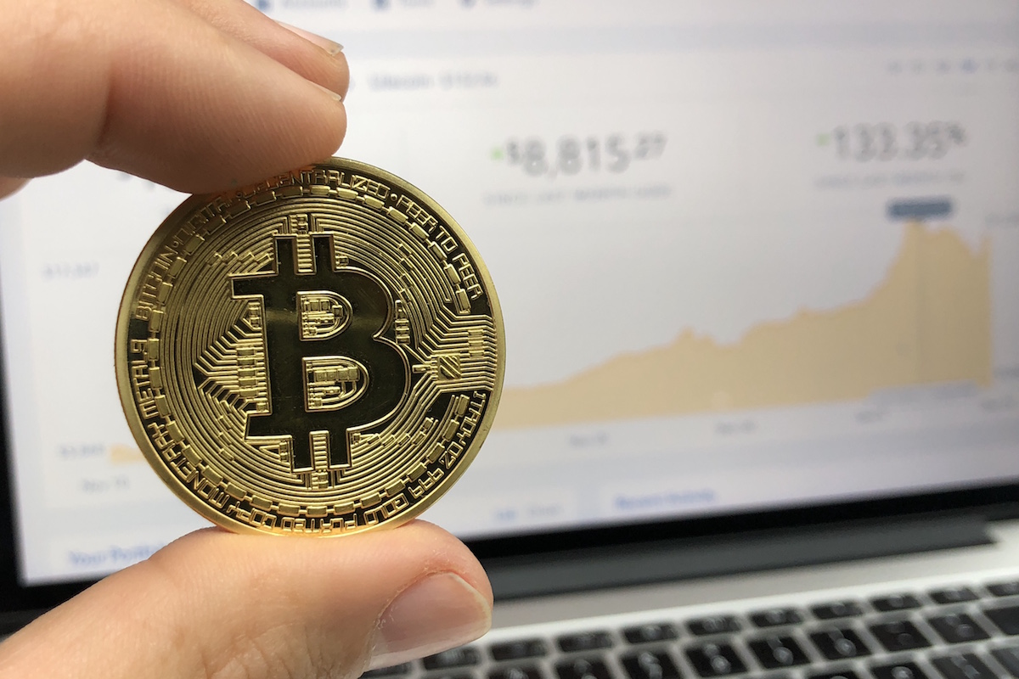
Bitcoin
Bitcoin is a decentralized digital currency that can be transferred on the peer-to-peer bitcoin network. Bitcoin transactions are verified by network nodes through cryptography and recorded in a public distributed ledger called a blockchain.

Slide 5
The history of Bitcoin
2008
Idea was published under the pseudonym Satoshi Nakamoto
2009
Start of the Bitcoin Network
2010
Fist cryptocurrency stock exchange is launched
2011
One Bitcoin equals one USD

Slide 6
The history of Bitcoin
2013
1 Bitcoin equals
100 USD
2014
Microsoft accepts Bitcoin
2017
1 Bitcoin equals
10,000 USD

Slide 7
Bitcoin ≠ blockchain
Is an application of blockchain technology
Is the underlying datastructure, which can be used for many things, including cryptocurrencies

Slide 8
What is A Blockchain?
A blockchain is a growing list of data blocks that are linked together.
Data
Data
Data
Reference
Reference
Reference

Slide 9
Bitcoin ecosystem
A public network in which anyone, including a malicious participant, can participate without restriction.
Even though it is not organized by a central authority, it works!

Slide 10
Bitcoin ecosystem The Bitcoin ecosystem is self-stabilizing. The more participants the system has, the more difficult manipulations become. And the more difficult manipulations become and the more participants there are, the greater the demand for Bitcoins. This results in a price increase, which in turn attracts new participants.
More Security
More Participants
Increased Bitcoin Value

Slide 11



Cutting the middleman Blockchain technology makes middlemen (so-called trusted third parties) obsolete in many applications. Bitcoin can serve as an example here. Bitcoins are not routed via a central instance, e.g. a bank, but can be transferred directly between the parties
E.g. direct transfer of Bitcoins

Slide 12

CREATING WITNESSES
If something is published on a public blockchain, all participants become witnesses.
This is used, for example, by OriginStamp to create a secure timestamp for documents.

Slide 13
Key Features
Write-only, immutable, transparent data storage
Resistant against malicious participants
Decentralized, no need for intermediaries
Open to everyone
Consistent state across all participants

Slide 14
challenges
Energy consumption
Scalability
Money laundering
Personal responsibility

Slide 15
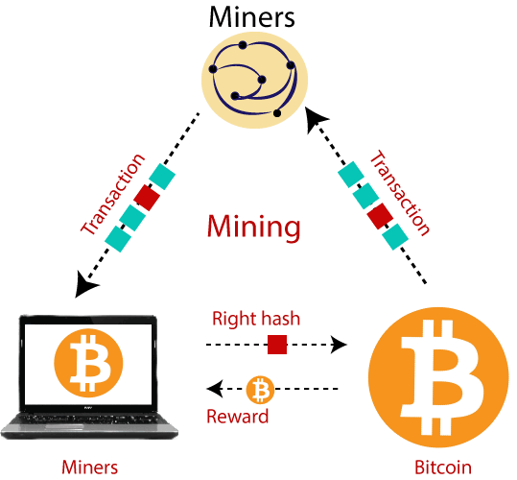
Bitcoin mining
Bitcoin mining refers to the process of authenticating and adding transactional records to the public ledger. The public ledge is known as the blockchain because it comprises a chain of the block.
Before we understand the Bitcoin mining concept, we should understand what Bitcoin is. Bitcoin is virtual money having some value, and its value is not static, it varies according to time. There is no Bitcoin regulatory body that regulates the Bitcoin transactions.

Slide 16
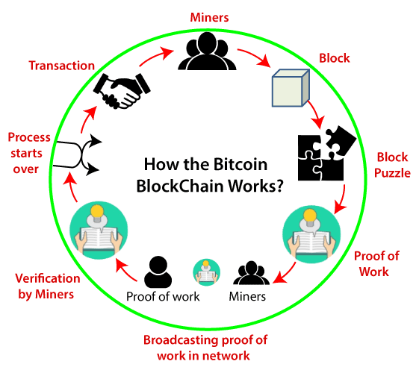
Working

Slide 17
THANK YOU

